Slide 1
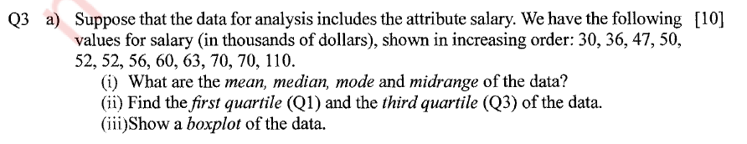
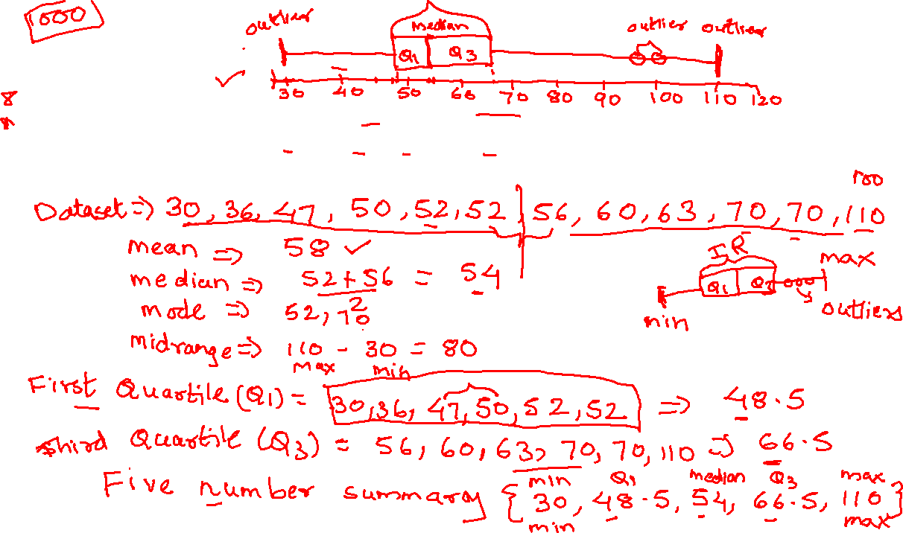
Box Plot

Slide 2

Data Collection & Sampling Methods
Chapter 2

Slide 3

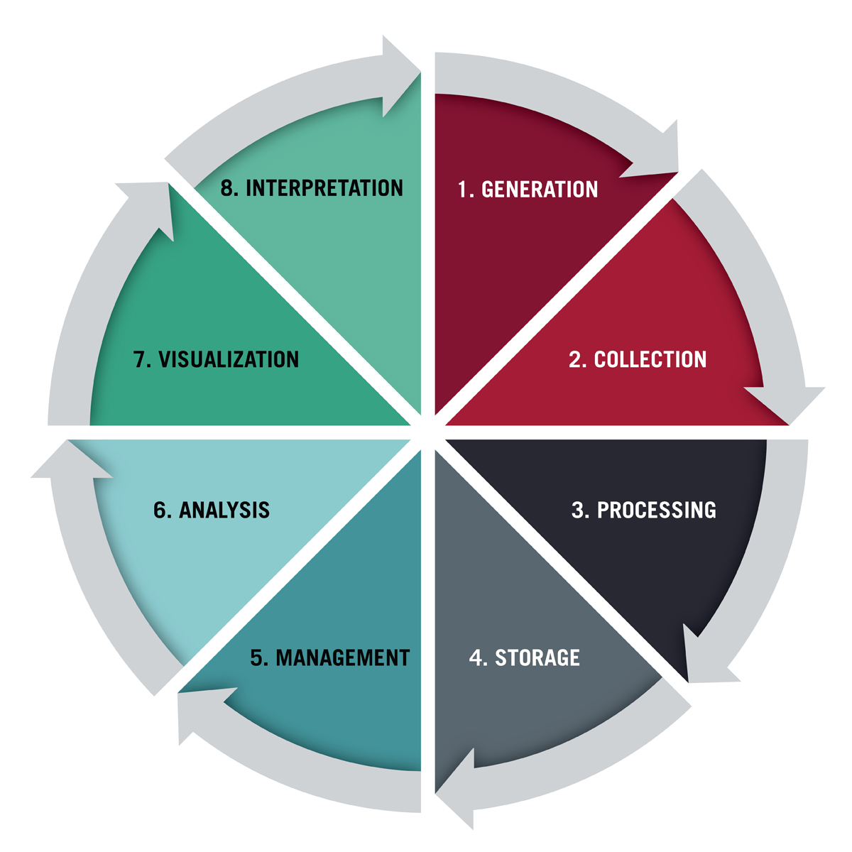
WHAT IS DATA COLLECTION?
Data collection is the methodological process of gathering information about a specific subject.
It’s crucial to ensure your data is complete during the collection phase and that it’s collected legally and ethically.
If not, your analysis won’t be accurate and could have far-reaching consequences.
Before collecting data, there are several factors we need to define:
The question you aim to answer
The data subject(s) you need to collect data from
The collection timeframe
The data collection method(s) best suited to your needs
data life cycle

Slide 4
Primary Data Vs Secondary Data
Primary Data
Primary data is the data that is collected for the first time through personal experiences or evidence, particularly for research.
It is also described as raw data or first-hand information.
The mode of assembling the information is costly.
The data is mostly collected through observations, physical testing, mailed questionnaires, surveys, personal interviews, telephonic interviews, case studies, and focus groups, etc.

Slide 5
Primary Data Vs Secondary Data
Secondary Data
Secondary data is a second-hand data that is already collected and recorded by some researchers for their purpose, and not for the current research problem.
It is accessible in the form of data collected from different sources such as government publications, censuses, internal records of the organisation, books, journal articles, websites and reports, etc.
This method of gathering data is affordable, readily available, and saves cost and time.
However, the one disadvantage is that the information assembled is for some other purpose and may not meet the present research purpose or may not be accurate.

Slide 6
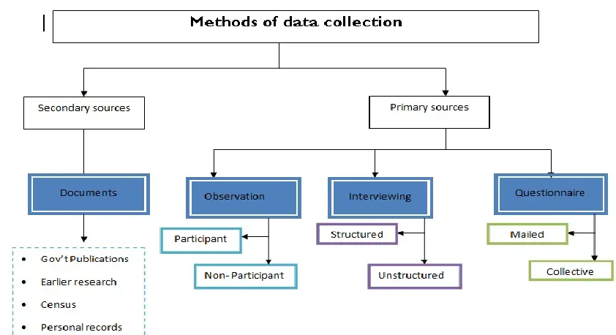
Methods of Data Collection

Slide 7
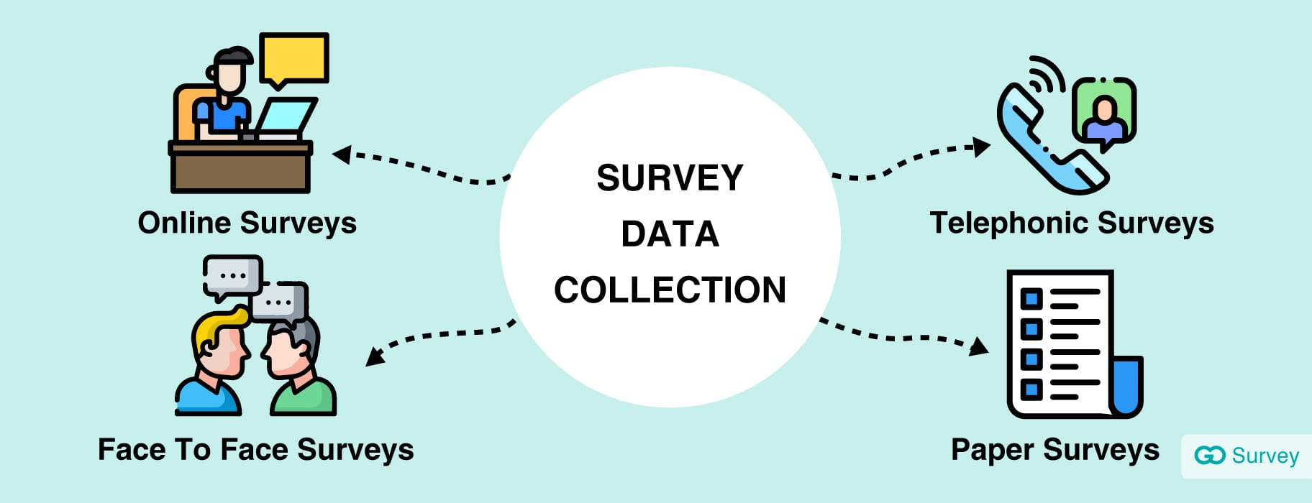
DATA COLLECTION METHODS
1. Surveys
Surveys are physical or digital questionnaires that gather both qualitative and quantitative data from subjects1.
The survey questions should not be
1. The Biased or Leading Question
“Our product reduces your tension by 10 percent. Would you like to buy it?”
How likely are you to buy this product?“
2. The Ambiguous Question
“How do you feel about your purchase?”
"How satisfied are you with your purchase?
3, Complex Question

Slide 8
The questionnaire
A questionnaire is a written list of questions, the answers to which are recorded by respondents.
In questionnaire respondents read the question, interpret what is expected and the write down the answers
A questionnaire can be administered in different ways..
A mailed questionnaire – one approach to collecting information is to send the questionnaire to prospective respondents by mail. Obviously, this method presupposes that u have access to their address. One of the major problem with this approach is the low response rate.
Collective administration – one of the best ways of administering questionnaires is to obtain a captive audience such as students in a class room, people attending a function, or people assembled in one place. This ensures a high response rate as you will find very few people refusing to participate in your study.

Slide 9
Forms of questions in a questionnaire
In a questionnaires, questions may be formulated as;
Closed ended or
Open ended
In a closed-ended question, the possible answers are set out in the questionnaire and the respondent ticks the category that best describes the respondents answer. E.g.
Please tick the type of research you would love to undertake.
Applied research Basic Research descriptive research quantitative
In open ended questions, the possible responses are not given. The respondent writes down the answers in his/her words. E.g.
Please explain why you opted for a Bachelors degree in Information technology?

Slide 10
Questionnaires…
When to use a questionnaire?
When resources and money are limited.
When it is necessary to protect the privacy of the participants.
When you want to collect data from a relatively bigger population.
Advantages | Disadvantages
Less expensive to administer mostly if the collective method is used. | Limited application.
Able to collect information from a larger sample | Lack of opportunity to clarify issues.
it offers greater anonymity. | Low response rate.
 | It is possible to consult others.
 | Spontaneous responses may not be possible mostly if it’s a mailed questionnaire.

Slide 11


DATA COLLECTION METHODS
2. Transactional Tracking
Each time your customers make a purchase, tracking that data can allow you to make decisions about targeted marketing efforts and understand your customer base better.
Example e-commerce and point-of-sale platforms
3. Interviews and Focus Groups
Interviews and focus groups consist of talking to subjects face-to-face about a specific topic or issue.
Interviews tend to be one-on-one, and focus groups are typically made up of several people.
Used to gather qualitative and quantitative data.
Time-consuming and expensive

Slide 12
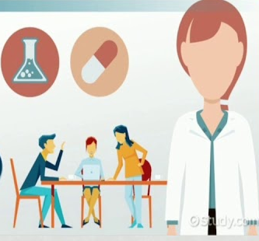
DATA COLLECTION METHODS
4. Observation
Observing people interacting with your website or product
can be useful for data collection because of the candor it offers.
If your user experience is confusing or difficult, you can witness it in real-time.
Observations enable you to see firsth and how users interact with your
product or site.
Both qualitative and quantitative data
5. Online Tracking and social media monitoring
To gather behavioral data, you can implement pixels and cookies. These are both tools that track users’ online behavior across websites and provide insight into what content they’re interested in and typically engage with.
6.Forms
Online forms are beneficial for gathering qualitative data about users, specifically demographic data or contact information. They’re relatively inexpensive and simple to set up, and you can use them to gate content or registrations, such as webinars and email newsletters.

Slide 13

Observational methods
OBSERVATION involves looking and listening very carefully.
We all watch other people sometimes, but we don’t usually watch them in order to discover particular information about their behaviour
TYPES OF OBSERVATION
Broadly classified as:
Structured Observation.
Unstructured Observation.
Participant Observation
Non-participant Observation

Slide 14

STRUCTURED OBSERVATION
Observation takes place strictly in accordance with a plan or a design prepared in advance.
Observation decides what to observe, what to focus on, what type of information or activity should be given importance, who are all to be observed, what conditions to be fulfilled to carry out observation, etc. in advance.
Example: patient reaction to hospital may be observed in different phases ­ the admission room, the initial contact with the ward, an element of the treatment phase, and on discharge from hospital. The structured observation approach is particularly useful for large scale studies and for testing hypothesis.

Slide 15
STRUCTURED OBSERVATION
Advantages:
Filtering what is relevant and focusing on it
Avoiding waste of time
Studying only the target group
Minimizing the bias of the observer, and
Elimination of any scope for vagueness/lack of clarity. Continue
Disadvantage
Unless a person is well trained he cannot be effective in undertaking structured observation
It is possible that vital aspects are missed, as they were not conceived at the time of designing the observation, and By limiting the independence of the observer, crucial things might be left out from being observed

Slide 16

Unstructured Observation
There is no advance designing of what, how, when, who, etc.
The observer is given the freedom to decide on the spot, to observe everything that is relevant
In this situation the researcher will take numerous field notes, and may use tape or video recording.
Example :Observing child playing with a new toy
Advantage The main strength of the unstructured observation is that at the time of observation everything is taken note of and the researcher then segregates the related and relevant details.
Disadvantage: One important quality required of the observer is that he should be well trained and experienced.

Slide 17
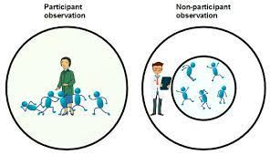
Participant Observation
Participant Observation
The observer is very much present in the midst of what is observed.
The observer will not miss anything which is relevant.
Advantage
There is very scope for him to clarify things which he cannot understand.
He can interact with people to get more information.
Disadvantage
An inexperienced observer may not know what is relevant and what is not relevant.
The conduct or behaviour or reaction of the target audience may be influenced by his presence.
He tends to focus more on things of interest to him, than what is relevant.

Slide 18
Non-participant Observation
Non-participant Observation
The observer remains detached from whatever is happening around and does not involve himself in any activities taking place.
He is present only to observe and not to take part in the activities.
Example: The plain clothe men [policemen not in uniform] are deputed on observation duty whenever a procession takes place or whenever any important political personality participates in the public meeting.
Important strength of this method:
Observer would collect first hand information without being noticed or influenced by anyone.
The observer performs his work in an environment or situation, which is very much planned or designed or set

Slide 19
Sampling
When secondary data are not available for the problem under study, a decision may be taken to collect primary data.
These data may be obtained by following either population method (census method) or sample method.
POPULATION METHOD OR CENSUS METHOD
Population represents the whole area .
Under the census or complete enumeration survey method, data are collected for each and every unit of the population or universe which is the complete set of items.
Example, if the average wages of workers in sugar industry in India is to be calculated, then it would be obtained from each and every worker working in the sugar industry. Then it is dividing the total wages received by the number of workers working in sugar industry. It is the average wages.
The population can be classified into two types:
(a) Finite or Infinite
(b) Real or Hypothetical.

Slide 20
Classification of population
Finite Population
If the number of elements can be counted in the population, then it is called finite population.
Example, number of students in a college, number of people in a
village, number of schools in a city.
Infinite Population
If the number of elements cannot be counted in the population, then it is called infinite population.
Example, number of stars in the sky, number of readers in a newspaper.
Real or Hypothetical Population
In real population the elements or items really exist.
For example, number of factories in a district, number of people in a city.
In hypothetical population, elements may not really exist; it is also known as
theoretical population. For example, tossing a coin or throwing a dice.

Slide 21
POPULATION OR CENSUS METHOD
Merits of Census Method
1. Data are obtained from each and every unit of the population.
2. Data results are more representative, accurate and reliable.
3. Data of complete enumeration census can be widely used as a basis for
various surveys.
4. The characters of all the limits of the population can be studied.
5. Intensive study is possible.
Demerits
1. It requires more time and cost.
2. It is not required for all types of research.
3. Inefficient and inexperience researcher may collect wrong information.

Slide 22
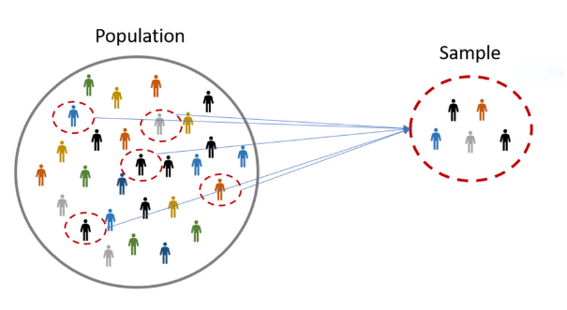
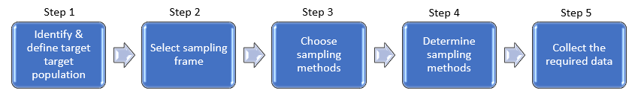
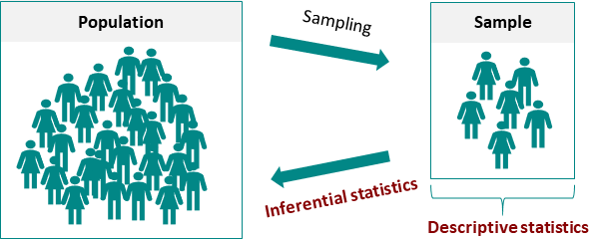
Sampling
Sampling is the process of learning about the population on the basis of a sample drawn from it.
A sample is a subset of population units.
Steps involved in sampling framework
Making an inference about the population
The basic objective of sample study is to draw inference about the population.

Slide 23
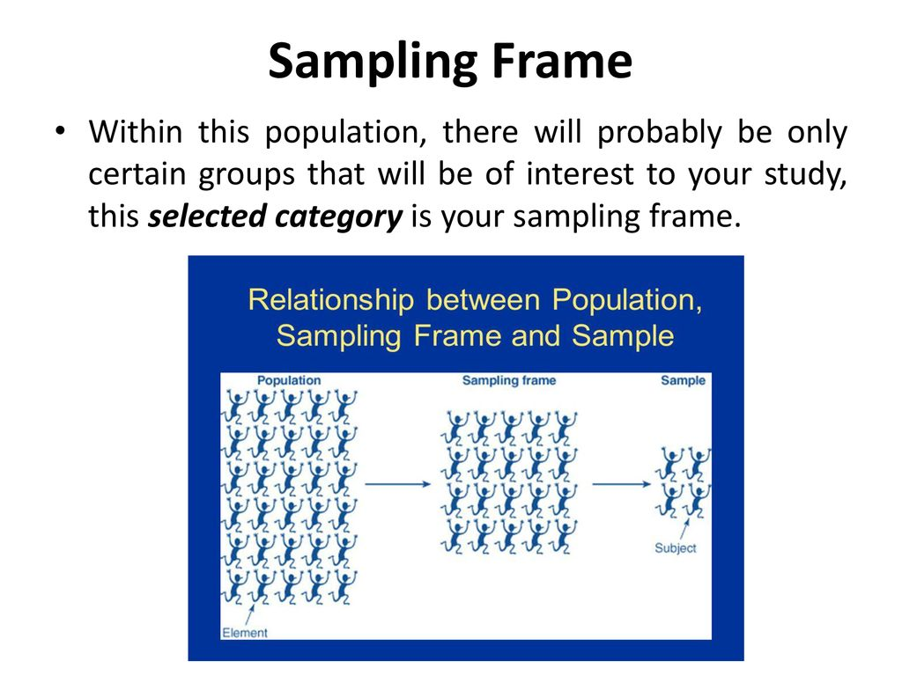
Sampling Frame
Within the population, there will probably be only certain groups that will be of interest to your study, the selected category is your sampling frame

Slide 24
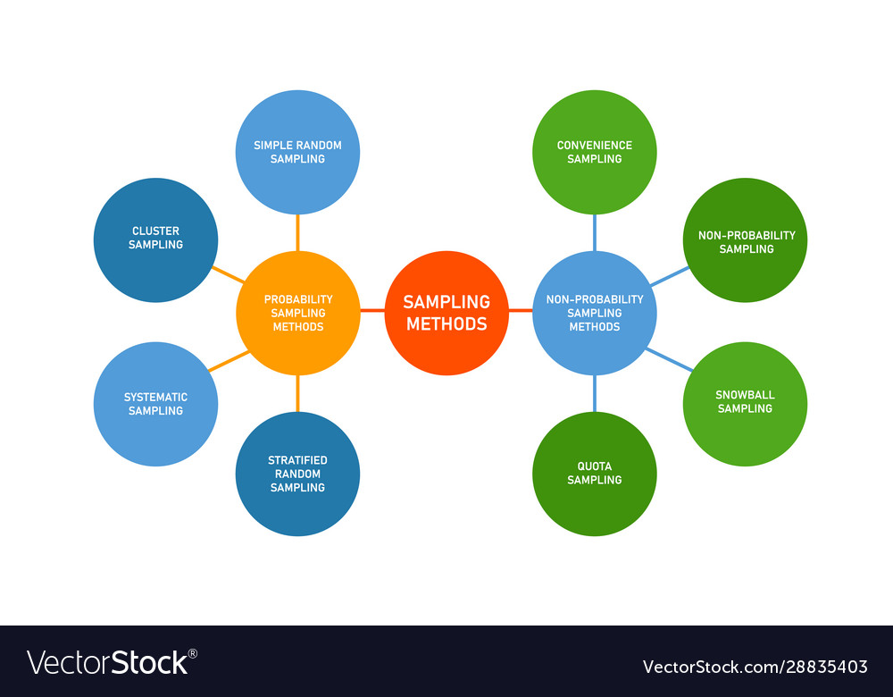
METHODS OF SAMPLING
Statistical data are collected under sampling through the various methods. They are tabulated as follows

Slide 25
Probability sampling methods
Probability sampling means that every member of the population has a chance of being selected.
It is mainly used in quantitative research.
To produce results that are representative of the whole population, probability sampling techniques are the most valid choice.
Example, in a population of 1000 members, every member will have a 1/1000 chance of being selected to be a part of a sample. Probability sampling eliminates bias in the population and gives all members a fair chance to be included in the sample

Slide 26
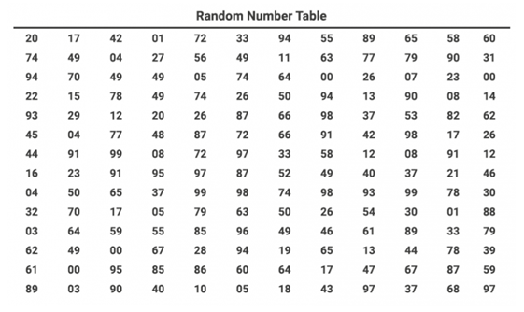
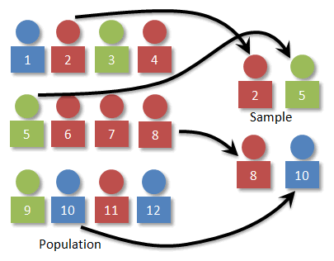
Probability sampling methods Simple Random Sampling
Simple random sampling is defined as a sampling technique where every item in the population has an even chance and likelihood of being selected in the sample.
the selection of items entirely depends on luck or probability.
Aim is to minimize any biases in the process of simple random sampling
Simple random sampling methods
prepare a list of all the population members initially, and then each member is marked with a specific number ( for example, there are nth members, then they will be numbered from 1 to N).
From this population, choose random samples using two ways:
random number tables
random number generator software
Method of lottery: Put 100 numbered bingo balls into a bowl (this is the population N).
Select 10 balls from the bowl without looking (this is your sample n).
It’s important not to look as you could (unknowingly) bias the sample.
The “lottery bowl” method can work fine for smaller populations.
Use of random numbers
Simple random sampling of a sample “n” of 3 from a population “N” of 12.

Slide 27
Simple Random Sampling
Example question: Outline the steps for obtaining a simple random sample for outcomes of strokes in U.S. trauma hospitals.
Make a list of all the trauma hospitals in the U.S.
Assign a sequential number to each trauma center (1,2,3…n). This is your sampling frame (the list from which you draw your simple random sample).
Figure out what your sample size is going to be
Use a random number generator to select the sample
For example, if your sample size is 50 and your population is 500, generate 50 random numbers between 1 and 500.

Slide 28
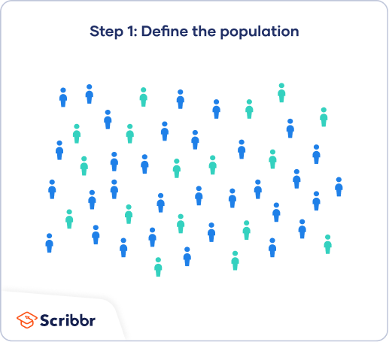
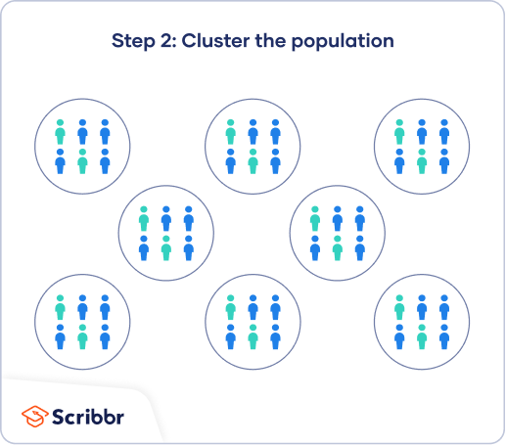
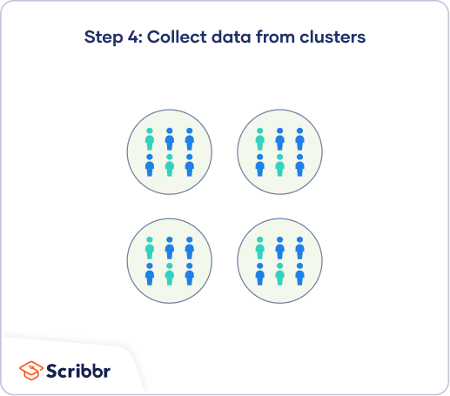
Cluster sampling
Step 1: Define your population Step 2: Divide your sample into clusters. Each cluster’s population should be as diverse as possible
Cluster sampling is a method where we divide the entire population into sections or clusters that represent a population.
Clusters are identified and included in a sample based on demographic parameters like age, sex, location, etc.
This makes it very simple for a survey creator to derive effective inference from the feedback.
Example, if the United States government wishes to evaluate the number of immigrants living in the Mainland US, they can divide it into clusters based on states such as California, Texas, Florida, Hawaii, etc.
This way of conducting a survey will be more effective as the results will be organized into states and provide insightful immigration data.
Step 3: Randomly select clusters to use as your sample

Slide 29
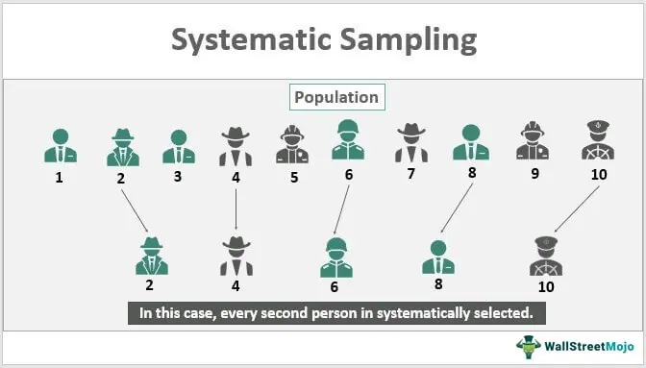
Systematic sampling
The systematic sampling method to choose the sample members of a population at regular intervals.
It requires the selection of a starting point for the sample and sample size that can be repeated at regular intervals.
This type of sampling method has a predefined range, and hence this sampling technique is the least time-consuming.
Example, a researcher intends to collect a systematic sample of 500 people in a population of 5000. He/she numbers each element of the population from 1-5000 and will choose every 10th individual to be a part of the sample (Total population/ Sample Size = 5000/500 = 10).

Slide 30
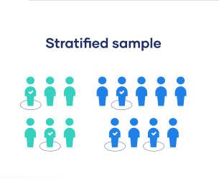
Stratified random sampling
Stratified random sampling is a method in which the researcher divides the population into smaller groups that don’t overlap but represent the entire population.
While sampling, these groups can be organized and then draw a sample from each group separately.
For example, to analyze the characteristics of people belonging to different annual income divisions will create strata (groups) according to the annual family income.
Eg – less than $20,000, $21,000 – $30,000, $31,000 to $40,000, $41,000 to $50,000, etc.
By doing this, the characteristics of people belonging to different income groups.
Marketers can analyze which income groups to target and which ones to eliminate to create a roadmap that would bear fruitful results.

Slide 31
Advantages Probability sampling methods
There are multiple advantages of probability sampling:
Reduce Sample Bias:
Probability sampling leads to higher quality data collection as the sample appropriately represents the population.
Diverse Population:
When the population is vast and diverse, it is essential to have adequate representation so that the data is not skewed towards one demographic.
For example, if Square would like to understand the people that could make their point-of-sale devices, a survey conducted from a sample of people across the US from different industries and socio-economic backgrounds helps.
Create an Accurate Sample:
Probability sampling helps the researchers plan and create an accurate sample. This helps to obtain well-defined data.

Slide 32
Non-probability sampling
The non-probability method is a sampling method that involves a collection of feedback based on statistician’s sample selection capabilities and not on a fixed selection process.
In most situations, the output of a survey conducted with a non-probable sample leads to skewed results, which may not represent the desired target population.
But, there are situations such as the preliminary stages of research or cost constraints, where non-probability sampling will be much more useful than the other type.

Slide 33
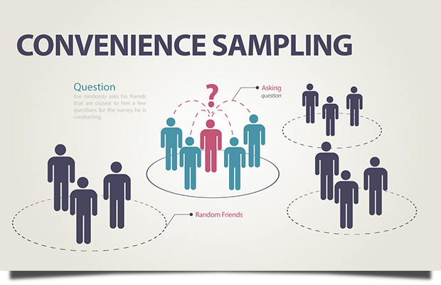
Convenience sampling
This method is dependent on the ease of access to subjects such as surveying customers at a mall or passers-by on a busy street.
It is usually termed as convenience sampling, because of the ease of carrying it out and getting in touch with the subjects.
In situations where there are resource limitations such as the initial stages, convenience sampling is used.
For example, startups and NGOs usually conduct convenience sampling at a mall to distribute leaflets of upcoming events or promotion of a cause – they do that by standing at the mall entrance and giving out pamphlets randomly.
Suppose a student is planning to open a food truck outside a college campus. They need to collect opinions based on the student’s choice of food to create their menu. The student will ask their friends and other students around campus to collect the data

Slide 34
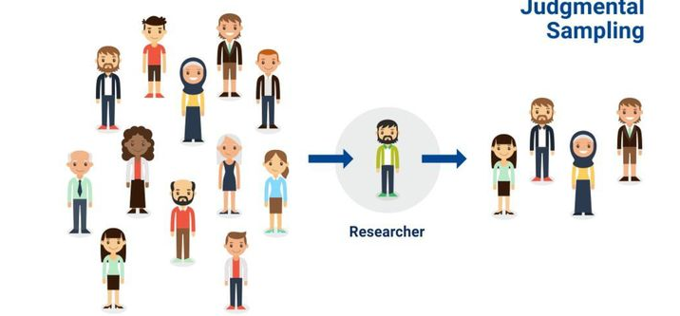
Judgmental or purposive sampling
Judgemental or purposive samples are formed by the discretion of the researcher.
Researchers purely consider the purpose of the study, along with the understanding of the target audience.
Example If you want to understand the thought process of people interested in studying for their master’s degree.
The selection criteria will be: “Are you interested in doing your masters in …?” and those who respond with a “No” are excluded from the sample.

Slide 35
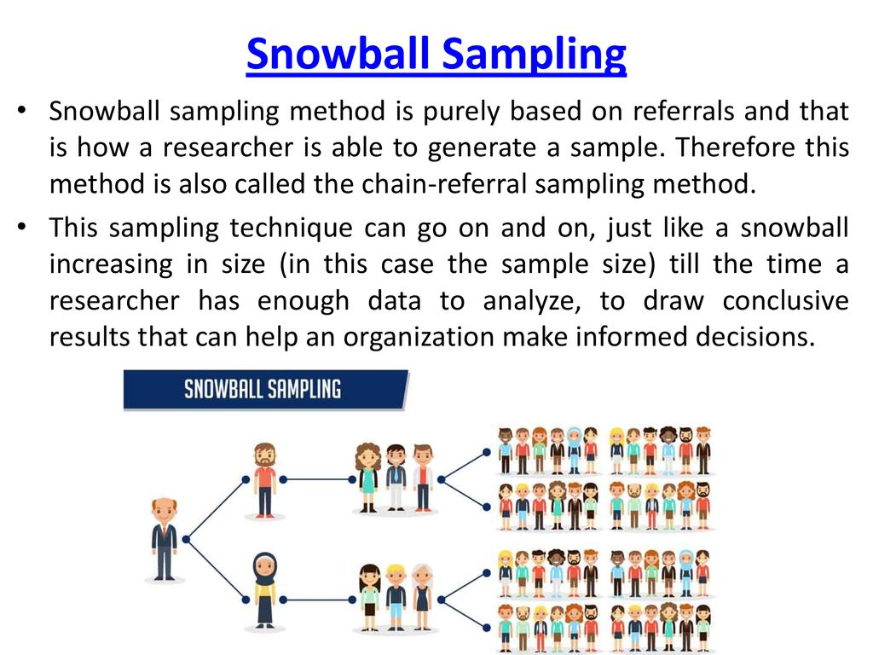
Snowball sampling
Snowball sampling is a sampling method that researchers apply when the subjects are difficult to trace.
For example, it will be extremely challenging to survey shelterless people or illegal immigrants.
In such cases, using the snowball theory, you can track a few categories to interview and derive results.
This sampling method is also implemented in situations where the topic is highly sensitive and not openly discussed—
Example, surveys to gather information about HIV Aids. Not many victims will readily respond to the questions. Still, we can contact people they might know or volunteers associated with the cause to get in touch with the victims and collect information.

Slide 36
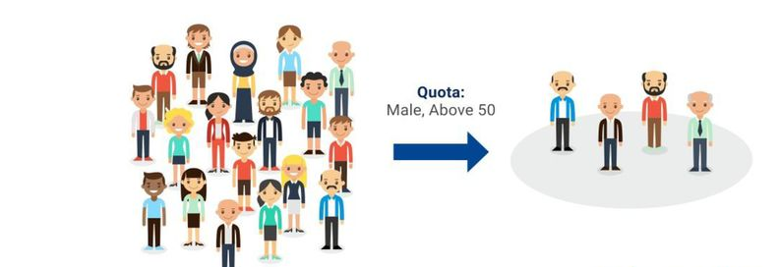
Quota sampling
In Quota sampling, the selection of members in this sampling technique happens based on a pre-set standard.
In this case, as a sample is formed based on specific attributes, the created sample will have the same qualities found in the total population.
It is a rapid method of collecting samples.

Slide 37
Advantages non-probability sampling
Non-probability sampling is used for the following:
Create a hypothesis: Researchers use the non-probability sampling method to create an assumption when limited to no prior information is available. This method helps with the immediate return of data and builds a base for further research.
Exploratory research: Researchers use this sampling technique widely when conducting qualitative research, pilot studies, or exploratory research.
Budget and time constraints: The non-probability method when there are budget and time constraints, and some preliminary data must be collected. Since the survey design is not rigid, it is easier to pick respondents at random and have them take the survey or questionnaire.

Slide 38
Differences between probability and non-probability
The main differences between probability and non-probability sampling methods.
Probability sampling | Non-probability sampling
Randomly selected samples | Subjective judgement of researchers are used to select samples
Equal chance for each member of population to get selected | Not everyone has equal chance to get selected
Used to reduce a sampling bias | Researcher is not overly concerned with sampling bias
Effective to collect data from diverse population | Useful in specific environment with sampling group members sharing similar characteristics
Useful in obtaining accurate representation of population | Does not help in representing the population

